Slide 1
Message Broker Build and Deploy Reusable Framework
Session Number: Q27
Parker Behseta
pbehset@us.ibm.com

Slide 2
Message Broker Administration
Message Broker Toolkit:
  GUI interface ideal for development and small runtime environments
Commands (toolkit and broker runtime)
  Extensive set of toolkit and broker runtime commands
Configuration Manager Proxy API
  Comprehensive set of API to administer broker domains.

Slide 3
What Framework IS NOT
Framework is not a substitute for existing configuration facilities of Message Broker.
  Framework builds added functionalities using existing Commands.
Framework is not about how to use ANT scripts to run Message Broker Commands
  There are many existing documentation on how to run MB
  Commands using ANT Scripts.
  Framework uses the existing ANT solutions.

Slide 4
What is Framework?
The Framework is a wrapper around existing technologies.
The Framework uses the existing facilities (i.e. Commands) with ANT scripts to fill out a GAP.
What is the GAP?

Slide 5
Why do we need a Framework?
Fortune 500 broker shop
Multiple broker environment
  Dev, SIT, QA, Preprod, Prod
Multiple brokers per environment:
  Business Domain broker Divisions
  Cross Business Domain Common Reusable broker Unit
Multiple Execution Group per broker
  Business Domain Sub Division execution group
  Cross Business Domain Common Reusable execution groups
Multiple artifacts per execution group
  Message flows with multiple versions
  Message sets with multiple versions
  Plug-in nodes with multiple versions
Dynamic, unpredictable environment
  Flexibility to pick and choose on the fly

Slide 6
Business Requirements
Create Standardized Projects.
Headless Build and Deploy of BAR files.
Environment Based Customization of Deployments.
Extend the Framework

Slide 7
Use case 1
Create Standardized Projects
Standard Nomenclature.
Ability to identify and relate the message artifacts to the message flow, execution group, and broker they belong to.
Ability to identify and relate the versions of message flow artifacts to the proper version of message flows, execution groups, and brokers.
Critical for development of a reusable framework.
Minimizes the input requirements to build and deploy Broker Archive (BAR) Files

Slide 8
Use case 2
Headless Build and Deploy of BAR files
On the fly and run time configured headless builds using proper versions of message artifacts, message flows, execution groups, and brokers.
Ability to keep track of build components and recreate a previous build.
Clearcase interaction.

Slide 9
Use case 3
Environment Based Customization of Deploys
Enforce environment based customization to all deployments
Customize individual artifacts for various environments.
Keep track of customizations and recreate the previous customizations.

Slide 10
Use case 4
Extend the Framework
Ability to work with Clearcase
Ability to deploy to multiple brokers.
Ability to deploy to multiple execution groups.
Ability to deploy to a selected number of execution groups running in multiple (not all) brokers.
Ability to deploy to all execution groups in one broker.
Ability to deploy to all execution groups in all brokers.

Slide 11
Framework Components
Windows Bat file
Ant Scripts
Project files
Configuration files

Slide 12
Framework Components

Slide 13
Use case 4
Extend the Framework
Ability to work with Clearcase
Implementation of Framework in Jython.
Ability to deploy to multiple brokers.
Ability to deploy to multiple execution groups.
Ability to deploy to a selected number of execution groups running in multiple (not all) brokers.
Ability to deploy to all execution groups in one broker.
Ability to deploy to all execution groups in all brokers.

Slide 14
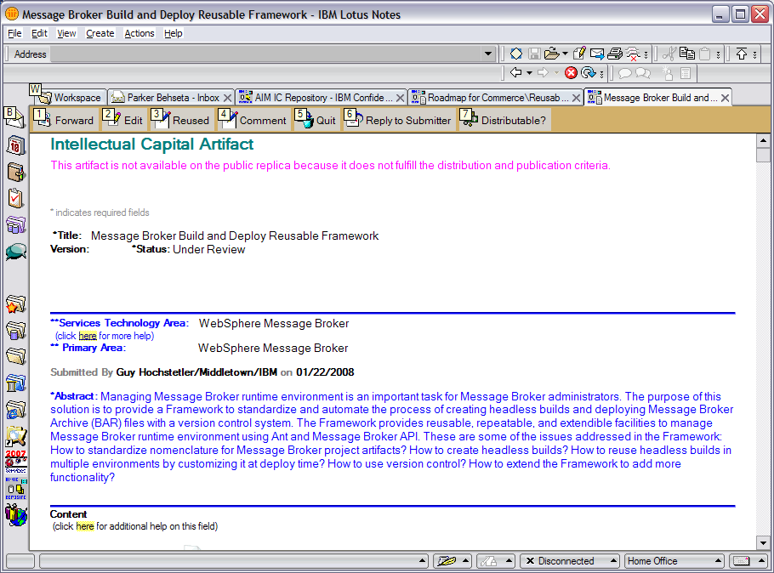
PBC … Click “Reused” button
Reused

Slide 15
Summary
Create Standardized Projects.
Headless Build and Deploy of BAR files.
Environment Based Customization of Deployments.
Extend the Framework

Slide 16
Questions
Please complete your session evaluation form
Thank you!!

